Slide 1
Monitoring System For Mountain Climbers Health using IOT and Machine Learning
Sashank Donavalli
Department of Computational Intelligence,
SRM Institute of Science and Technology,
Chennai.
Harshitha Kambham
Department of Computational Intelligence,
SRM Institute of Science and Technology,
Chennai.
Dr.B.Pitchaimanickam
Department of Computational Intelligence,
SRM Institute of Science and Technology,
Chennai.

Slide 2
CONTENTS
Abstract
Introduction
Objective
Literature Survey
Proposed Model
Modules
Transmitter Side
Receiver Side
Results
Conclusion
Future work
References

Slide 3
ABSTRACT
Using IoT technology, the Mountain Climbers Monitoring System offers a novel way to solve safety problems in mountain climbing. This system is designed to monitor climbers' vital signs in real time, follow their whereabouts, and evaluate the surrounding environment in order to improve safety and speed emergency response in remote alpine areas. Important components include sensors such as temperature sensors, accelerometers, pulse rate sensors, and GPS modules to track the physiological characteristics of climbers, as well as an integrated Internet of Things architecture to send data in real time to a central monitoring platform. The data collected and transmitted by climbers may be used in the Mountain Climbers Monitoring System with Node MCU, a well-liked open-source development board built on the ESP8266 Wi-Fi module. The Mountain Climbers Monitoring System may use LoRa (long-range) technology to send data from the wearable devices to the central monitoring platform. The data is collected from the transmitter’s end LoRa, and the data is transmitted to the receiver's end LoRa. The data is shared on the IOT open-source webpage Blynk. If there are any abnormalities found, the alarming message is displayed on the LCD on the receiver's end. Machine learning models such as KNN, decision trees, Naive Bayes, logistic regression, random forests, and SVM are used to test the real-time data on trained data.

Slide 4
INTRODUCTION
Monitoring systems for mountain climbers are essential resources for improving performance and safety in alpine settings. These advanced technologies integrate real-time data collection, GPS tracking, and biometric sensors to provide climbers with essential information on weather conditions, altitude, and vital signs.
In this paper, we explore how machine learning (ML) algorithms and IoT can be used to create advanced monitoring systems designed with mountain climbers in mind. These solutions promise to improve safety measures and provide vital predictive skills by combining IoT sensors with ML-driven analytics. This allows for proactive reactions to possible threats and crises in isolated mountainous areas.

Slide 5
OBJECTIVES
The primary objective of this project is to design and implement an IoT-based Mountain Climbers Monitoring System that addresses the challenges.
The system should provide real-time monitoring of climbers' vital signs, track their location, and assess environmental conditions to enhance safety and facilitate rapid emergency response in mountainous terrains.
Additionally, the system should be energy-efficient, durable, and capable of seamless communication between climbers and relevant authorities.

Slide 6
LITERATURE SURVEY
Title of the Paper | Proposed Model | Limitations
E. N. Ardina, A. E. Jayati, M. Sipan, Erlinasari, R. K. Pramuyanti and P. Muliandhi, "Tracking Device for The Mountaineers Using GPS," 2022 IEEE International Conference on Communication, Networks and Satellite (COMNETSAT), Solo, Indonesia, 2022, pp. 328-332 | Navigation systems that use GPS devices still depend on the presence of cellular telecommunications signals. Therefore, the telecommunication system in the navigation system still has shortcomings | Wireless sensor devices, if not optimized, may have higher power consumption, leading to shorter battery life. The range of a wireless sensor network may be limited, potentially resulting in communication gaps in vast and remote mountain areas.
P. Vinoth Kumar et al., "Health and Position Tracking for Mountain Climbers," 2023 9th International Conference on Advanced Computing and Communication Systems (ICACCS), Coimbatore, India, 2023, pp. 2052- | The health and position tracking system with GPS to detect the live location and furthermore measuring the temperature and heartbeat of the climber is proposed in the work which overcomes the shortcomings of the techniques used by the mountain climbers. Global System for Mobile Communication (GSM) module is also connected with the device for interfacing the messages, ease of accessing network | GPS and GSM enhance tracking, challenges persist in extreme environments, affecting climbers' safety and the system's effectiveness. Limited or no GSM coverage may hinder the system's ability to transmit vital information to the rescue team.

Slide 7
LITERATURE SURVEY
Title of the Paper | Proposed Model | Limitations
Novel silk hydrogel-based material for wearable energy harvesting and sensing mountaineers’ activities,IEEE,2023, Raheel Riaz; Martina Aurora Costa Angeli; Abraham Mejia-Aguilar; Roberto Monsorno; Bhaskar Dudem; S. Ravi P. Silva; Luisa Petti | This work introduces a novel flexible composite material, a silk-glycerol hydrogel, for stable wearable self-power sensors. Designed for extreme weather sports, the hydrogel exhibits temperature-independent mechanical and triboelectric properties, maintaining functionality in cold temperatures (up to -20°C). | The presented wearable self-power sensors using silk-glycerol hydrogel exhibit limitations in extreme weather conditions, with untested performance in temperatures below -20°C. While promising for bio-mechanical sensing, concerns arise about the sensors' reliability and functionality, especially in harsh cold environments where stable operation is critical.
Multi-Hop Data Delivery in Hybrid Self-Organized Networks for Mountain Rescue Shih-Xiu Huang;An Lung; Jia-You Chen;Wu-Min Sung;Yu-Cheng Chu;Jiun-Yu Tu; Chih-Lin Hu 2023 IEEE | A hybrid self-organized network architecture is designed for efficient mountain rescue, utilizing UAVs and wireless nodes to establish unstructured multi-hop networks. Two search methods, passive and active, enable climbers to send messages for help, and UAVs equipped with cameras perform face recognition for detecting targets. | It relies on the assumption of available UAVs, and the efficacy in extreme mountainous terrain remains untested. The system's real-world adaptability, especially in adverse weather conditions and varying terrains, needs validation for reliable mountain rescue operations.

Slide 8
LITERATURE SURVEY
Title of the Paper | Proposed Model | Limitations
Formation tracking of target moving on natural surfaces;2023;IEEE; H. Nadour N. Marchand;L. Reveret;P. Legreneur | The paper focuses on forming a UAV swarm to track a moving target in mountainous terrain. It emphasizes dispatching the swarm effectively around the climber, considering environmental constraints. The algorithm ensures collision avoidance, target visibility, and maintains formation compactness. | It focuses on 2D scenarios, lacking validation for 3D environments. The algorithm's real-world adaptability and robustness in dynamic mountainous conditions remain untested, requiring further exploration for practical applications.
Peltier integrated heating & cooling jacket, J. R. Poikayil, J. Francis, D. Saju, A. Suresh and J. Varghese, "Peltier integrated heating & cooling jacket," 2017 | The proposed system addresses the challenges of varying weather conditions, offering a user-controlled suit to regulate body temperature. It aims to prevent health issues caused by extreme climates, providing an efficient solution for outdoor enthusiasts facing temperature extremes | It may not fully prevent health issues caused by abrupt temperature changes. The effectiveness of the suit in mitigating acute mountain sickness and high altitude cough requires empirical validation.

Slide 9
LITERATURE SURVEY
Title of the Paper | Proposed Model | Limitations
Development of Climber Location Information Sharing System in Japanese Northern Alps; K. Ishisaka, K. Kobayashi, Y. Oguri and Y. Honma, 2019;IEEE | A climber location-sharing system is developed using 150 MHz radio. Climbers carry mobile devices transmitting GPS-based location data to detectors in mountain lodges. The utilizes a Wi-Fi-connected network and cloud storage for widespread accessibility. | It relies on climbers carrying mobile devices, which may not be foolproof. Signal transmission can be hindered by obstacles, and the system assumes network connectivity, potentially limiting its effectiveness in remote mountainous areas.
W. Aziz et al., "Emergency Power Pack with Navigation System for Mount Climber," 2020 4th International Conference on Electrical, Electronics and System Engineering (ICEESE), Kuala Lumpur, Malaysia, 2018, pp. 91-95, doi: 10.1109/ICEESE.2018.8703554. | This project addresses mount climbers' power challenges by creating an emergency power pack with renewable energy (solar-wind) and GPS navigation. The pack aims to prevent crises, offering a panic button for sending emergency messages with precise location to the rescue team via SMS. | Reliance on renewable energy sources, which may be insufficient during prolonged bad weather. The SOS feature's effectiveness depends on network availability, impacting its reliability in remote mountainous regions during emergencies.

Slide 10
LITERATURE SURVEY
Title of the Paper | Proposed Model | Limitations
J. Rathbum, A. Sharky, P. Urunkar, A. Saleem and P. Hazaveh, "Developing a Climbing Assistive Exoskeleton*," 2023 Systems and Information Engineering Design Symposium (SIEDS), Charlottesville;IEEE | The paper introduces a Climbing Assistive Exoskeleton (CAE) designed to alleviate stress on climbers' fingers, aiming to reduce injuries and enhance climbing endurance. The glovelike device utilizes resistance bands, a motor, and real-time feedback for a targeted 20-40N force reduction in finger-related climbing strain. | Untested real-world adaptability, potential discomfort in extended use, and reliance on electromyography sensors. The device's effectiveness in diverse climbing scenarios and user comfort may require iterative refinement and validation.
Y. V. K. Reddy and M. L. Ramanaiah, "Solving Economic Load Dispatch Problem with Mountaineering Team-Based Optimization Technique,“;2023;IEEE | The paper introduces the Mountaineering Team-Based Optimization (MTBO) algorithm for solving complex Economic Load Dispatch (ELD) problems, considering practical constraints. The MTBO algorithm demonstrates superior efficiency, robustness, and ease of implementation in optimizing global solutions for ELD. | MTBO faces complexity due to practical constraints.

Slide 11
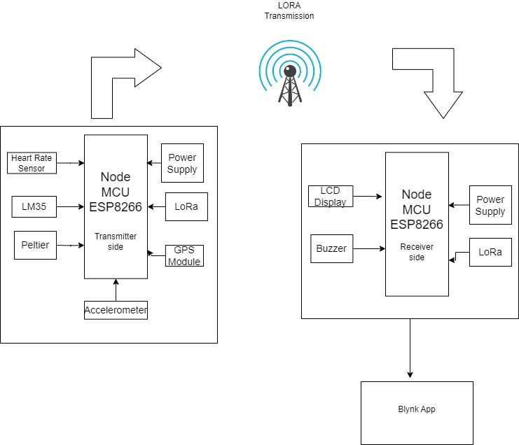
PROPOSED SYSTEM
The proposed model tries to overcome the difficulties the climbers face with the network signals in the mountaineering regions. Instead of using the GSM module, the paper proposes LoRa for transmitting the data through the receiver side. The collected data is passed to a machine learning model to get a prediction of the condition of the climber.
The architecture of the proposed model has a receiver and transmitter side. The data from sensors is collected and controlled by the Node MCU. The data from the transmitter side is transmitted through LoRa to LoRa on the receiver’s end. The receiver’s end has an alarming system alert in case of any abnormal activities.
Proposed model

Slide 12
MODULES
GPS Module: Enables real-time location tracking to aid navigation and emergencies.
Heart Rate Monitor: Monitors climbers' heart rates for health and safety purposes, helping to prevent overexertion.
LoRa: The LoRa Module allows you to communicate to the LoRaWAN wireless network, a network made for the IoT.
Temperature Sensors (LM35): Monitors environmental conditions to help climbers prepare for changing weather and avoid extreme conditions.
NodeMCU: NodeMCU is a low-cost open-source IoT platform. It initially included firmware which runs on the ESP8266 Wi-Fi.
Battery Management System: Ensures reliable power supply for all modules during extended climbs by optimizing energy usage.

Slide 13
MODULES
Peltier: Peltier module (thermoelectric module) is a thermal control module used for warming effects. Passing an electric current through the module makes it possible to change the surface temperature and keep it at the target temperature.
Accelerometer: Incorporates sensors to detect sudden falls or impacts, triggering automatic alerts for potential emergencies.
Battery Management System: Ensures reliable power supply for all modules during extended climbs by optimizing energy usage.

Slide 14
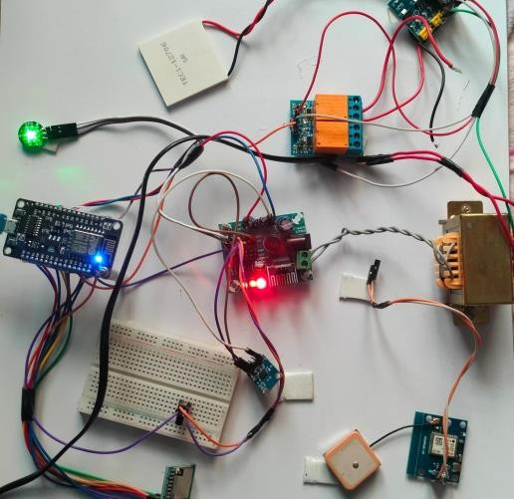
TRANSMITTER SIDE
Sensor Integration: Node MCU is fitted with a number of sensors, including GPS, temperature, heart rate, and an accelerometer to gather information about the environment and position that is pertinent to the application.
LoRa Integration: A LoRa transceiver module, such as the SX1278, is linked to the Node MCU long- distance wireless data transmission handled by the LoRa module.
Data Gathering and Transmission: The Node MCU gathers sensor data and formats it appropriately for long-range communication, which is made possible by applying LoRa modulation to this data. Next, the Node MCU uses LoRa modulation to transfer this data packet.
Transmission Control: In order to maximize communication dependability and power consumption, the Node MCU regulates the frequency and timing of data. It does this by making sure that data is transferred on appropriate LoRa channels and at acceptable intervals.
Transmitter side

Slide 15
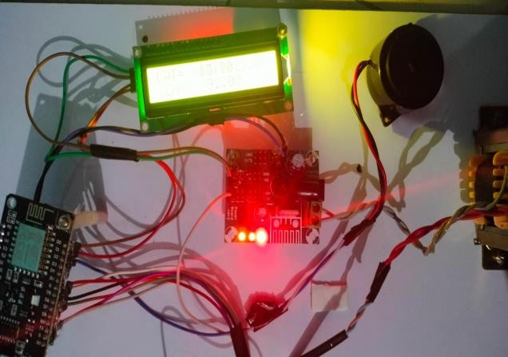
RECEIVER SIDE
LoRa: Upon receipt of a LoRa transmission, the Node MCU swiftly processes the incoming data packet using LoRa demodulation.
Integration with the Blynk App: The Node MCU is also wirelessly linked to the Blynk IoT platform. Blynk offers an intuitive user interface for controlling and monitoring Internet of Things devices. Because of the Node MCU's programming, users may access and interact with the device remotely using the Blynk app.
Real-Time Control and Monitoring: Users may watch live data from the Node MCU using the Blynk app. In addition to monitoring environmental conditions and receiving warnings or notifications based on specified criteria, they may view sensor readings. The Blynk app could additionally have tools for tracking data and logging history.
Receiver Side

Slide 16
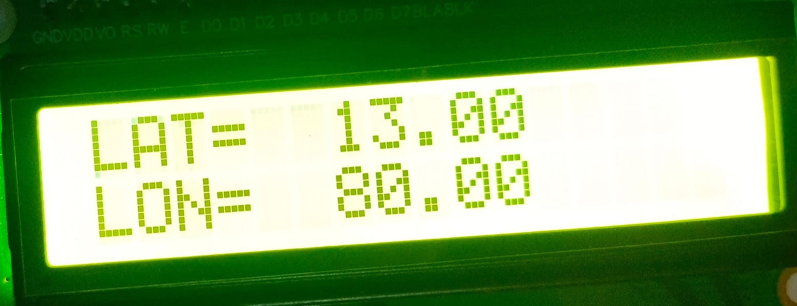
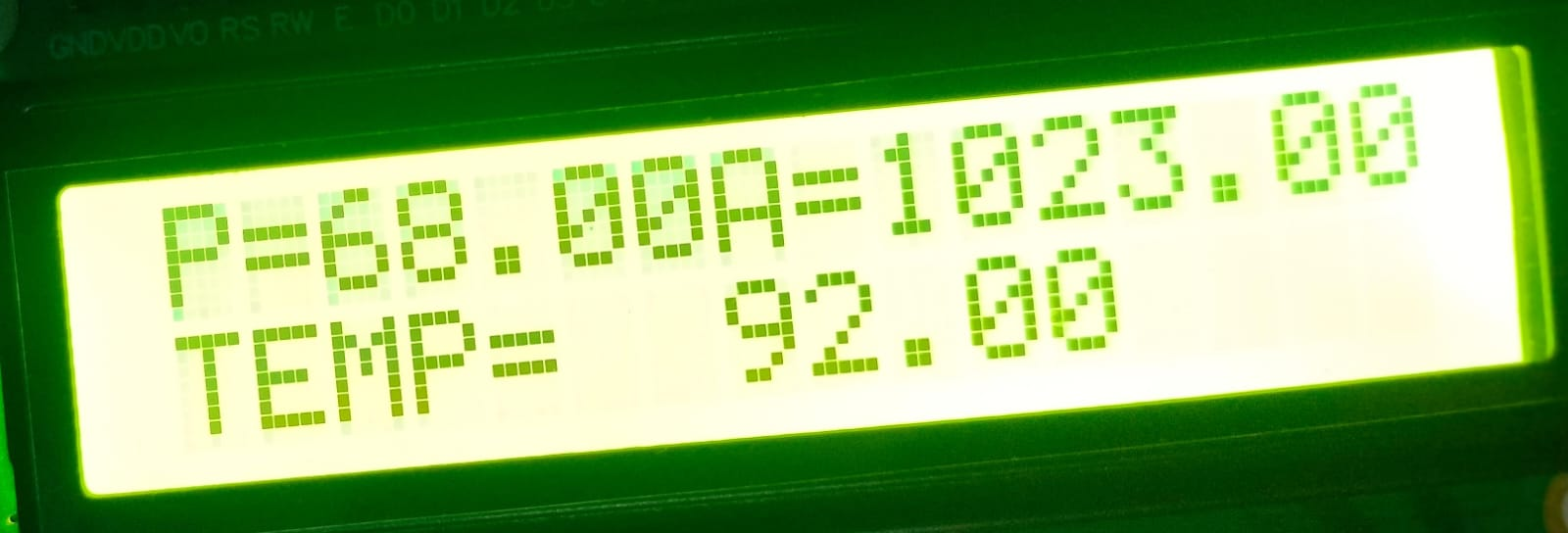
IOT RESULTS
The prototype for monitoring systems for mountain climbers using IoT (Internet of Things) technology, specifically LoRa (Long Range) and Node MCU represents a cutting-edge solution for enhancing safety and efficiency during mountain expeditions.
The transmitter side transmitting the climber’s physiological data to the receiver’s end.
The receiver side Figure 10 receives the data from the transmitter side; the data is updated on the Blynk IOT platform.
LCD Display

Slide 17
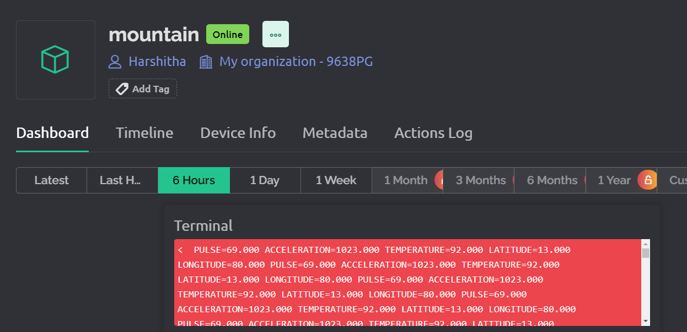
BLYNK APP RESULTS
Blynk is a versatile mobile application that can be seamlessly integrated into monitoring systems for mountain climbers utilizing IoT (Internet of Things) and machine learning technologies. Its user-friendly interface and customizable widgets make it an ideal platform for displaying real-time data and facilitating communication between climbers and their support teams. Here's how the Blynk app enhances the monitoring system for mountain climber.
Blynk app Display

Slide 18
ML RESULTS
The accuracy of machine learning models is measured by their ability to correctly predict outcomes compared to the total number of predictions made. The accuracy is determined by dividing the number of right predictions by the total number of forecasts. Higher accuracy values indicate better performance.
S.NO | ML Model | Accuracy
1 | KNN | 98.74
2 | Decision Tree | 98.70
3 | Naïve Bayes | 97.64
4 | Logistic Regression | 98.77
5 | Random Forest | 98.77
6 | SVM | 97.96
Machine Learning models Accuracy Results

Slide 19
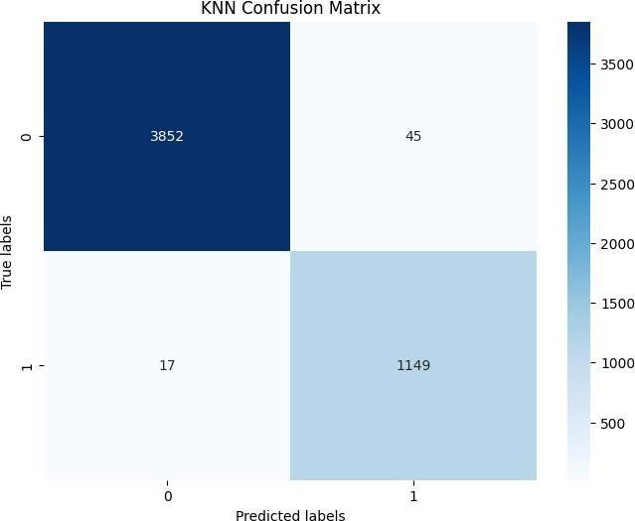
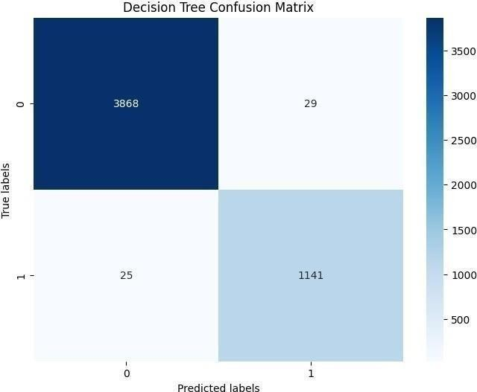
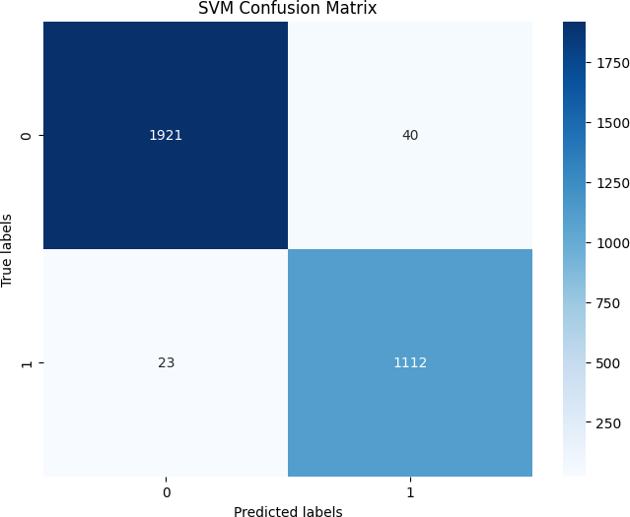
ML RESULTS
A confusion matrix is a performance evaluation tool in machine learning. It organizes predictions from a classifier into a table, comparing them against actual outcomes. It consists of four values: true positives, true negatives, and false positives and false negatives, offering insights into model accuracy and errors.
SVM Confusion matrix
KNN Confusion matrix
Decision Tree Confusion matrix

Slide 20
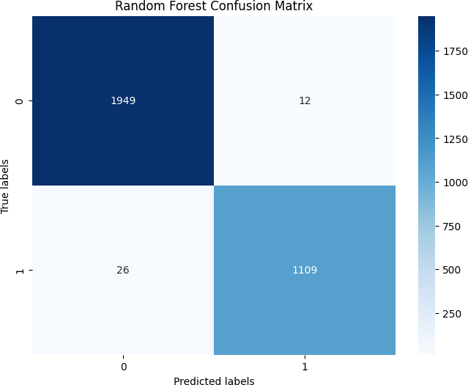
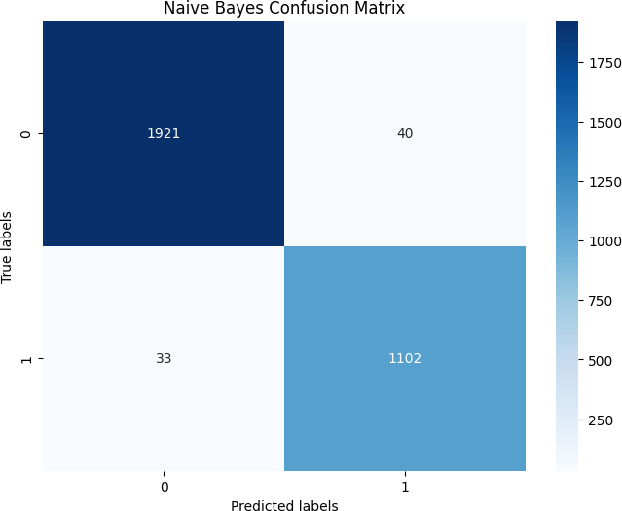
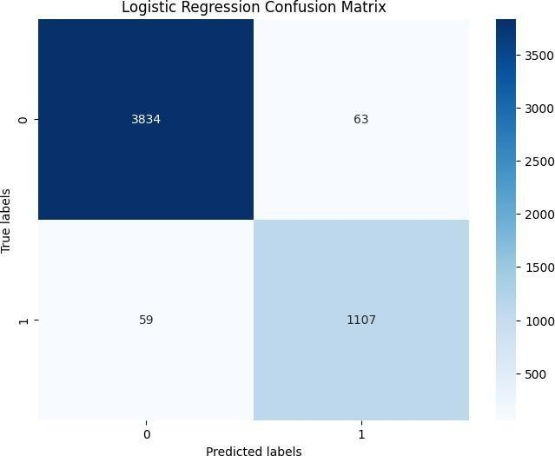
ML RESULTS
Random Forest Confusion matrix
Naïve Bayes Confusion matrix
Logistic Regression Confusion matrix

Slide 21
CONCLUSION
The proposed model is able to provide remote communication through a LoRa device.
Thus, the rescue team is able to rescue the climber during any abnormal conditions.
The proposed model also uses a machine learning model to provide predictions of the climber’s health. Random forest and logistic regression performed slightly better than other models.
By leveraging real-time data collection and analysis, these systems offer climbers access to crucial information regarding physiological parameters and emergency response mechanisms.

Slide 22
FUTURE WORK
Improved Sensor Technology: Develop and integrate advanced sensor technology capable of capturing a wider range of physiological parameters with higher accuracy and reliability. This could include wearable devices with enhanced biometric sensors and environmental sensors to monitor air quality, temperature, and altitude.
Integration of Real-Time Feedback: Implement systems that provide real-time feedback to climbers based on the analysis of their health data. This could include personalized suggestions for adjusting activity levels, hydration, or rest periods to optimize performance and reduce the risk of fatigue or injury.
Long-Term Health Monitoring: Expand the scope of monitoring systems to include long-term health tracking beyond individual expeditions. By collecting and analyzing data over extended periods, researchers can gain deeper insights into the long-term effects of high-altitude climbing and develop personalized strategies for maintaining optimal health and performance over time.

Slide 23
References
[1] Ardina, Elfira Nureza, Ari Endang Jayati, Muhammad Sipan, Roni Kartika Pramuyanti, and Puri Muliandhi. "Tracking device for the mountaineers using GPS." In 2022 IEEE International Conference on Communication, Networks and Satellite (COMNETSAT), pp. 328-332. IEEE, 2022.
[2] P. Vinoth kumar, S. N. Kumar, D. Gunapriya, M. S. Jaganath, K. R. Kalidas, P. Murali Manohar, and R. Prajith, “Health and Position Tracking for Mountain Climbers”, In 2023 9th International Conference on Advanced Computing and Communication Systems (ICACCS), vol. 1, pp. 2052-2056. IEEE, 2023.
[3] Riaz, Raheel, Martina Aurora Costa Angeli, Abraham Mejia-Aguilar, Roberto Monsorno, Bhaskar Dudem, S. Ravi P. Silva, Paolo Lugli, and Luisa Petti, “Novel silk hydrogel-based material for wearable energy harvesting and sensing mountaineers’ activities”, In 2023 IEEE International Workshop on Metrology for Industry 4.0 & IoT (MetroInd4. 0&IoT), pp. 118-123, IEEE, 2023.
[4] Huang, Shih-Xiu, An Lung, Jia-You Chen, Wu-Min Sung, Yu-Cheng Chu, Jiun-Yu Tu, and Chih-Lin Hu. "Multi-Hop Data Delivery in Hybrid Self-Organized Networks for Mountain Rescue." In 2023 IEEE 12th Global Conference on Consumer Electronics (GCCE), pp. 117-118. IEEE, 2023.
[5] Nadour, Housseyne, Nicolas Marchand, Lionel Reveret, and Pierre Legreneur. "Formation tracking of target moving on natural surfaces." In 2021 International Conference on Unmanned Aircraft Systems (ICUAS), pp. 295-302. IEEE, 2021.

Slide 24
References
[6] Poikayil, Jeena Raju, Jeffy Francis, Deepa Saju, Akhil Suresh, and Jobin Varghese. "Peltier integrated heating & cooling jacket." In 2017 International conference of Electronics, Communication and Aerospace Technology (ICECA), vol. 2, pp. 260-263. IEEE, 2017.
[7] Ishisaka, K., K. Kobayashi, Y. Oguri, and Y. Honma. "Development of climber location information sharing system in Japanese northern Alps." In 2019 URSI Asia-Pacific Radio Science Conference (AP-RASC), pp. 1-1. IEEE, 2019.
[8] Aziz, Wafi, Norain Rahim, Wan Norhisyam Abd Rashid, Zaidi Tumari, Shamsul Rahimi Subki, Muzaffar Kadir, Siti Asma Che Aziz, and Nurul Saqinah Abdul Aziz. "Emergency Power Pack with Navigation System for Mount Climber." In 2018 4th International Conference on Electrical, Electronics and System Engineering (ICEESE), pp. 91-95. IEEE, 2018.
[9] Rathbum, Jared, Austin Sharky, Prathamesh Urunkar, Ashraf Saleem, and Paniz Hazaveh. "Developing a Climbing Assistive Exoskeleton." In 2023 Systems and Information Engineering Design Symposium (SIEDS), pp. 102-107. IEEE, 2023.
[10] Reddy, YV Krishna, and M. Laxmidevi Ramanaiah. "Solving Economic Load Dispatch Problem with Mountaineering Team-Based Optimization Technique." In 2023 Second International Conference on Electrical, Electronics, Information and Communication Technologies (ICEEICT), pp. 1-6. IEEE, 2023.

Slide 25
References
[11] Tee, Wei Zhong, Rushit Dave, Naeem Seliya, and Mounika Vanamala. "Human Activity Recognition models using Limited Consumer Device Sensors and Machine Learning." In 2022 Asia Conference on Algorithms, Computing and Machine Learning (CACML), pp. 456-461. IEEE, 2022.
[12] Shaikh, Hammad, Abid Muhammad Khan, Muhammad Rauf, Asim Nadeem, Muhammad Taha Jilani, and Muhammad Talha Khan. "IoT based linear models analysis for demand-side management of energy in residential buildings." In 2020 Global Conference on Wireless and Optical Technologies (GCWOT), pp. 1-6. IEEE, 2020.
[13] Alhenawi, Esra’A., Ruba Abu Khurma, Ahmad A. Sharieh, Omar Al-Adwan, Areej Al Shorman, and Fatima Shannaq. "Parallel ant colony optimization algorithm for finding the shortest path for mountain climbing." IEEE Access 11 (2023): 6185-6196.
[14] Song, Yu, Yanxi Mao, and Zeyu Li. "A comprehensive survey of pole climbing robots." In 2022 IEEE International Conference on Mechatronics and Automation (ICMA), pp. 870-875. IEEE, 2022.
[15] Hossain, Md Julhas, Md Amdadul Bari, and Mohammad Monirujjaman Khan. "Development of an IoT based health monitoring system for e-Health." In 2022 IEEE 12th Annual Computing and Communication Workshop and Conference (CCWC), pp. 0031-0037. IEEE, 2022.

Slide 26
References
[16] Elias, Jakob R., Ryan Chard, Joseph A. Libera, Ian Foster, and Santanu Chaudhuri. "The manufacturing data and machine learning platform: enabling real-time monitoring and control of scientific experiments via IoT." In 2020 IEEE 6th World Forum on Internet of Things (WF-IoT), pp. 1-2. IEEE, 2020.
[17] Anderies, Anderies, Raihan Andika Haerudin, Valerie Aurelia Tan, Jessen Kanigara, and Andry Chowanda. "iPlant: Implementation of An Automatic Plant Watering System Using NodeMcu ESP8266 and Blynk." In 2023 11th International Conference on Information and Communication Technology (ICoICT), pp. 159-164. IEEE, 2023.
[18] Ko, Sungwook, Hyunji Song, Yulim Cho, Jiwon Chung, Sojeong Kim, Daeun Yim, Daehan Jin, and Anthony Smith. "LoRa network performance comparison between open area and tree farm based on PHY factors." In 2018 IEEE Sensors Applications Symposium (SAS), pp. 1-6. IEEE, 2018.
[19] Reddy, G. Pradeep, and YV Pavan Kumar. "Demystifying LoRa wireless technology for IoT applications: concept to experiment." In 2021 4th International Symposium on Advanced Electrical and Communication Technologies (ISAECT), pp. 01-06. IEEE, 2021.
[20] Kumar, Saket, Ashutosh Gupta, Gaurav Yadav, and Hemender Pal Singh. "Peltier module for refrigeration and heating using embedded system." In 2015 International Conference on Recent Developments in Control, Automation and Power Engineering (RDCAPE), pp. 314-319. IEEE, 2015.

Slide 27
Thank You

